Slide 1
Module - 3
Scheduling

Slide 2
Content:
- Processes Scheduling
- CPU Scheduling
- Pre-emptive Scheduling
- Non-Pre-emptive Scheduling
- Resource allocation and Management
- Deadlocks
- Deadlock Handling Mechanisms

Slide 3
Scheduling:
While most programmes have some alternative CPU cycle shuffling and waiting for some form of I/O.
The time spent waiting for I/O is wasted in a simple machine running a single operation.
A scheduling mechanism enables the CPU to be used by one process while another is waiting for I/O.
The idea is to make the operating system construction as "effective" and "reasonable" as possible. It is subject to different in often complex situations, and often subject to changing policy objectives.

Slide 4
CPU Cycle:
CPU cycle generally, the time needed for one basic processor operation, such as an addition, to be executed; this time is usually the reciprocal clock rate. The word was traditionally used for the time needed for one basic (e.g. add or subtract) computer instruction to be fetched and executed.

Slide 5
CPU Scheduler:
It is the task of the CPU Scheduler to pick another process from the ready queue to run next once the CPU becomes idle.
A FIFO queue is not necessarily the storage structure for the ready queue and the algorithm used to pick the next process.
As well as various customizable parameters for each algorithm, there are many alternatives to choose from, which is the fundamental subject of this entire module.

Slide 6
Pre-emptive and non pre- emptive Scheduling:
One of the following situation, CPU scheduling decisions take place:
Whenever a process terminates.
Whenever a process transitions from the running state to the waiting state, such as a wait() system call for an I/O request or invocation.
Whenever a process switches from the waiting state to the ready state, say at completion of I/O or a return from wait( ).
iv) Whenever a process switches from the running state to the ready state, for example in response to an interrupt.

Slide 7
Dispatcher:
The dispatcher is the module that gives control of the CPU to the process selected by the scheduler. This function involves:
• Switching context.
• Switching to user mode.
• Jumping to the proper location in the newly loaded program.
- The dispatcher needs to be as fast as possible, as it is run on every context switch. The time consumed by the dispatcher is known as dispatch latency.

Slide 8
Scheduling Criteria:
There are several different criteria to consider when trying to select the "best" scheduling algorithm for a particular situation and environment, including:
CPU utilization- a computer's usage of processing resources
Throughput - the amount of work completed in a unit of time
Turnaround time
Waiting time
Load average
Response time

Slide 9
FCFS
Process Burst Time
P₁ 24
P₂ 3
P₃ 3
Suppose that the processes arrive in the order: P₁ , P₂ , P₃ The Gantt Chart for the schedule is:
Waiting time for P₁ = 0; P₂ = 24; P₃ = 27
Average waiting time: (0 + 24 + 27)/3 = 17
P₁
P₂
P₃
0
24
27
30

Slide 10
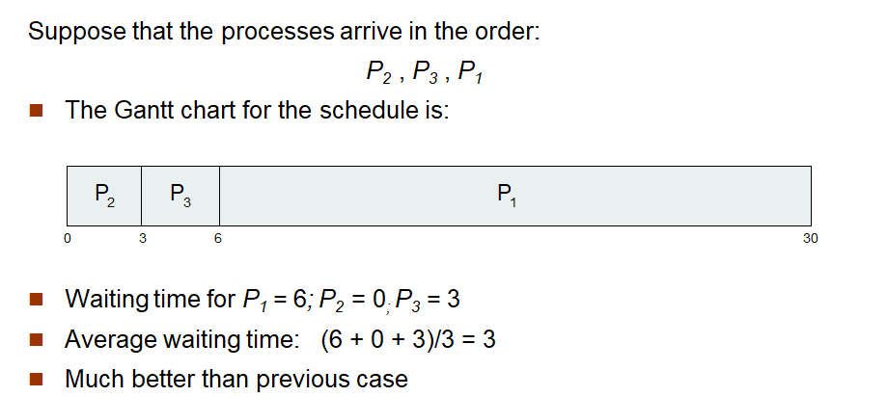
FCFS

Slide 11
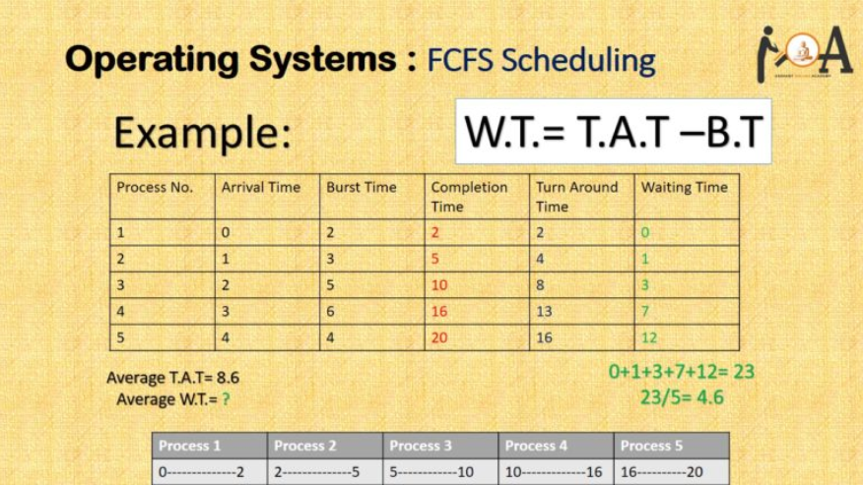
First-Come First-Serve Scheduling, FCFS:

Slide 12
First-Come First-Serve Scheduling, FCFS:

Slide 13
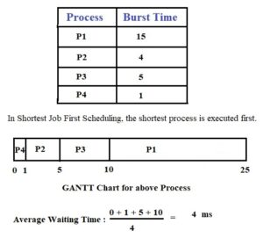
Shortest-Job-First Scheduling, SJF:

Slide 14
Shortest-Job-First Scheduling, SJF:

Slide 15
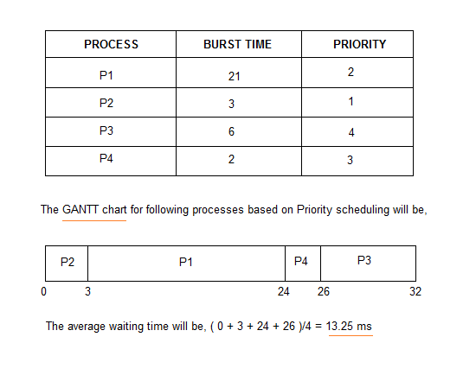
Priority Scheduling, PS:

Slide 16
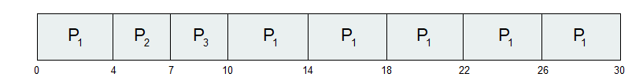
Round Robin(RR)
Round Robin (RR)
Process Burst Time
P₁ 24
P₂ 3
P₃ 3
The Gantt chart is:

Slide 17
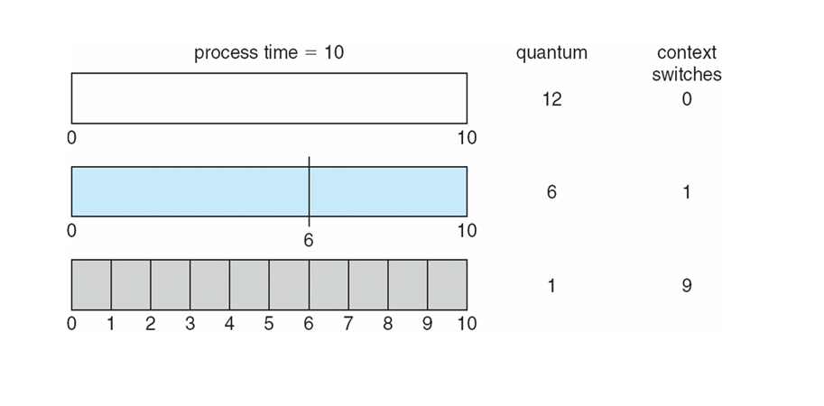
Time Quantum and Context Switch Time

Slide 18
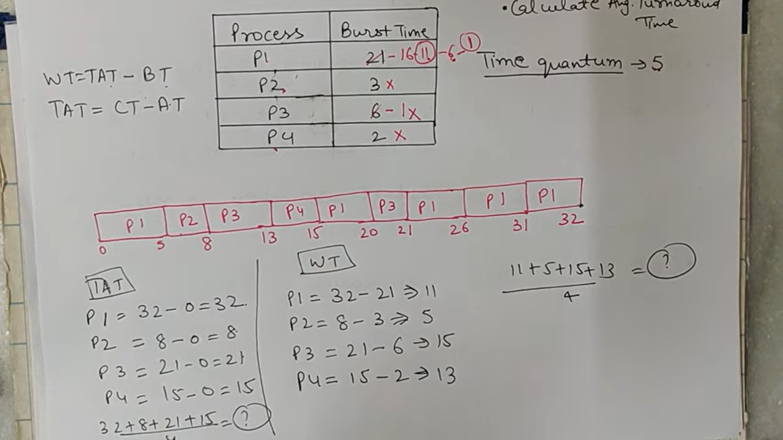

Slide 19
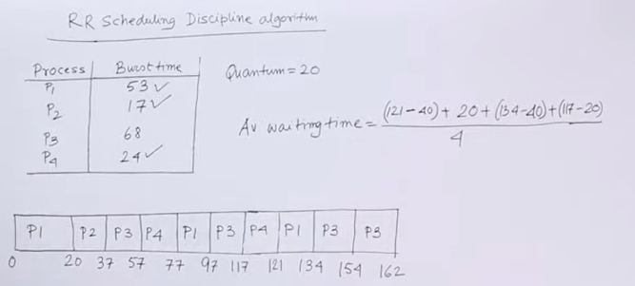

Slide 20
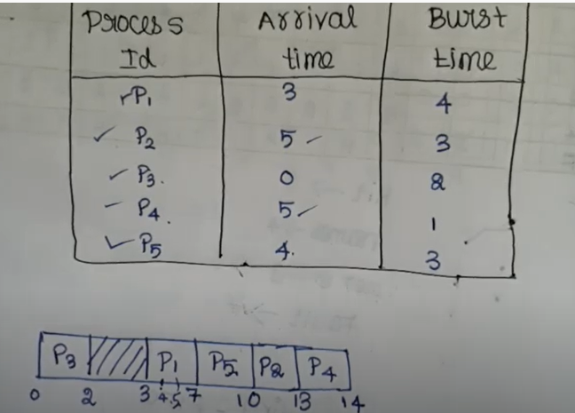
FCFS

Slide 21
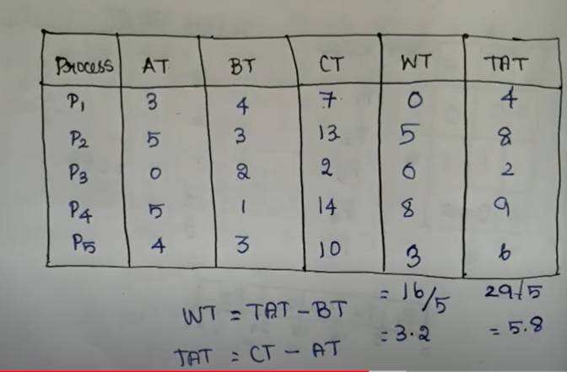

Slide 22
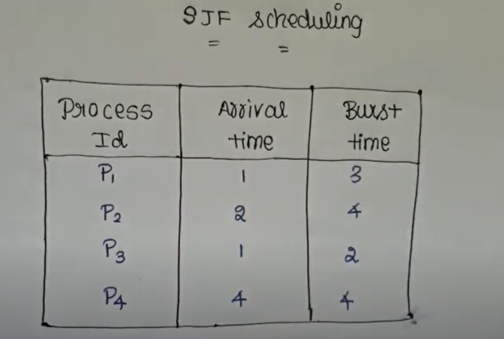

Slide 23
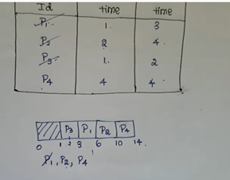

Slide 24
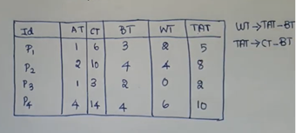

Slide 25
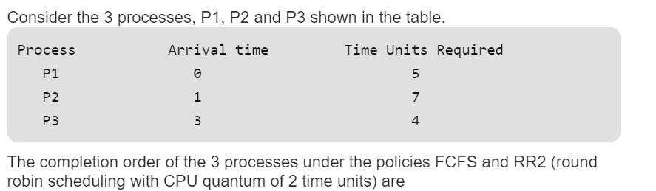

Slide 26
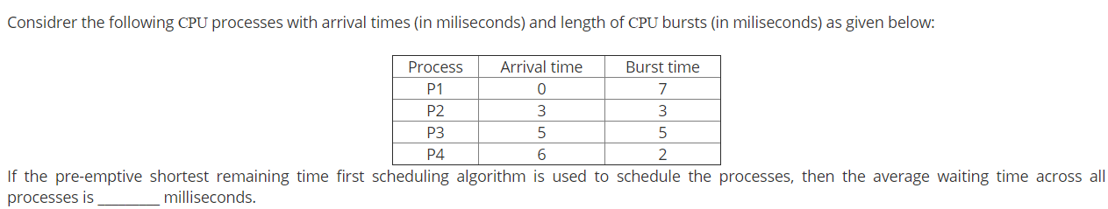

Slide 27
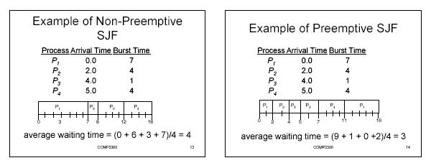
Shortest-Job-First Scheduling, SJF:

Slide 28
Shortest-Job-First Scheduling, SJF:

Slide 29
Shortest-Job-First Scheduling, SJF:

Slide 30
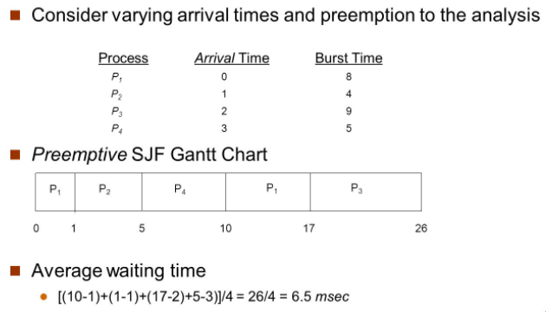
Shortest Remaining Time First Scheduling, SRTF:

Slide 31
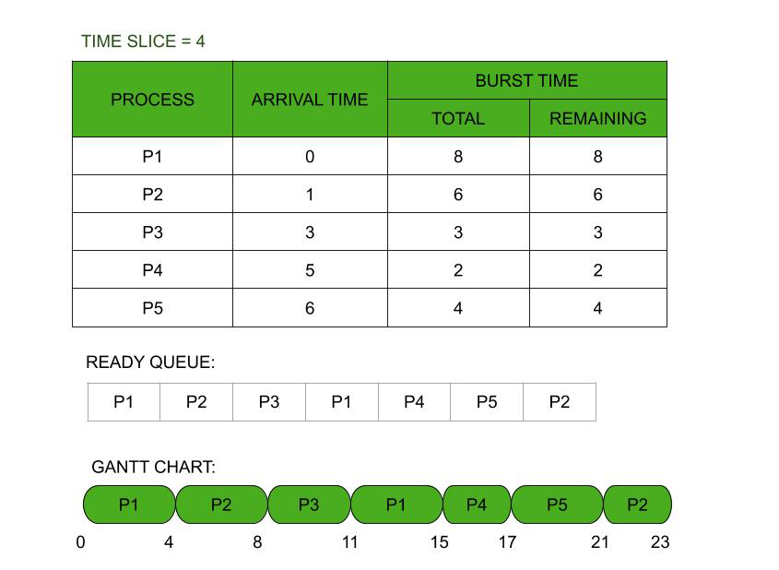

Round Robin Scheduling, RRS:

Slide 32
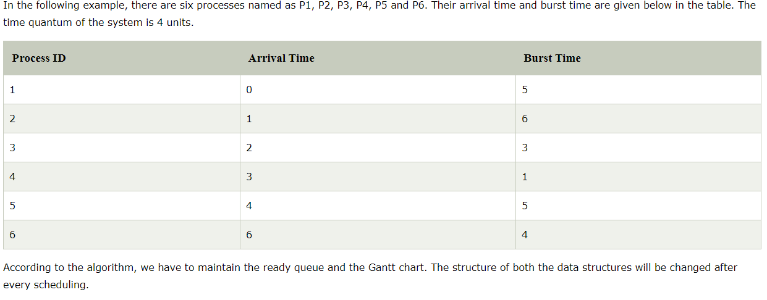
Round Robin Scheduling, RRS:

Slide 33
Round Robin Scheduling, RRS:

Slide 34
Round Robin Scheduling, RRS:

Slide 35
Round Robin Scheduling, RRS:

Slide 36
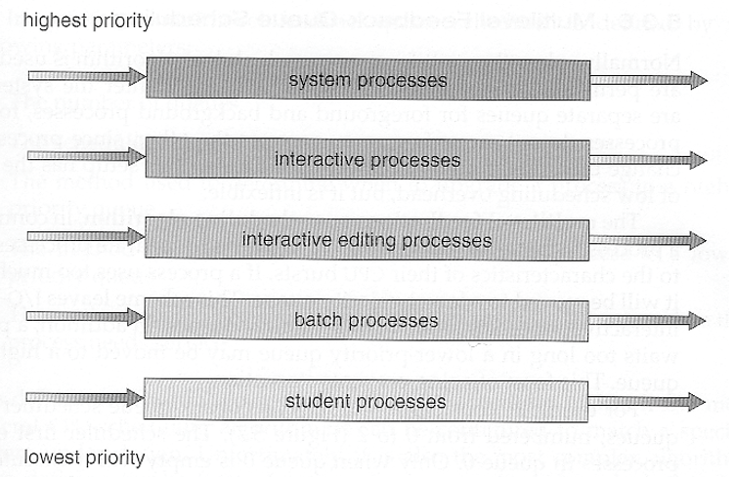
Multilevel Queue Scheduling, MQS:

Slide 37
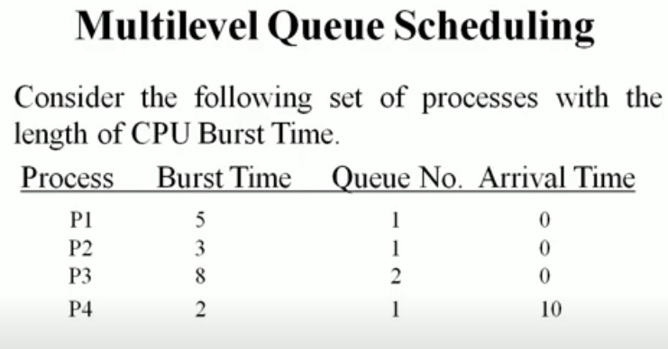
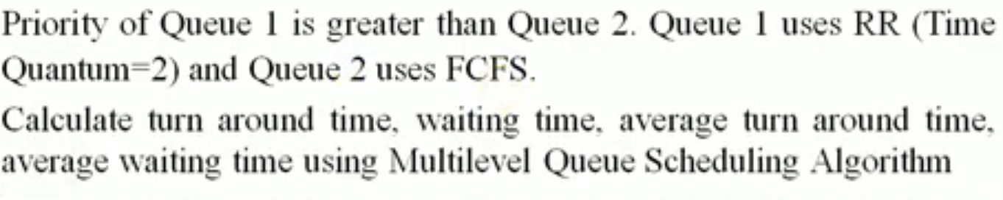

Slide 38
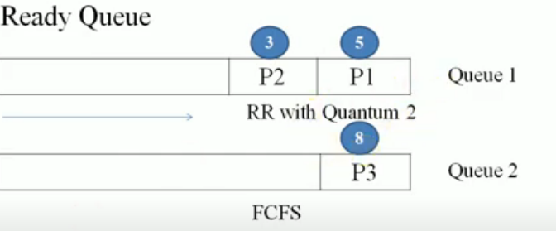

Slide 39
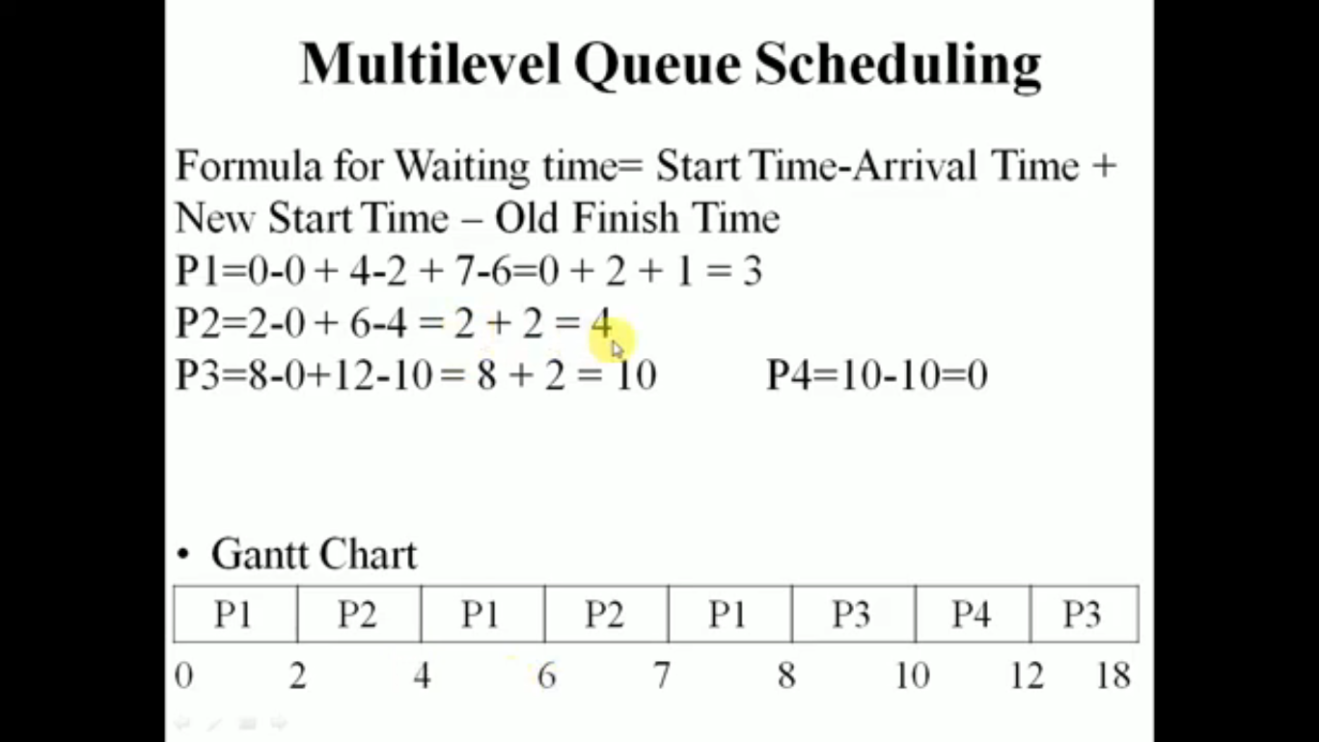

Slide 40
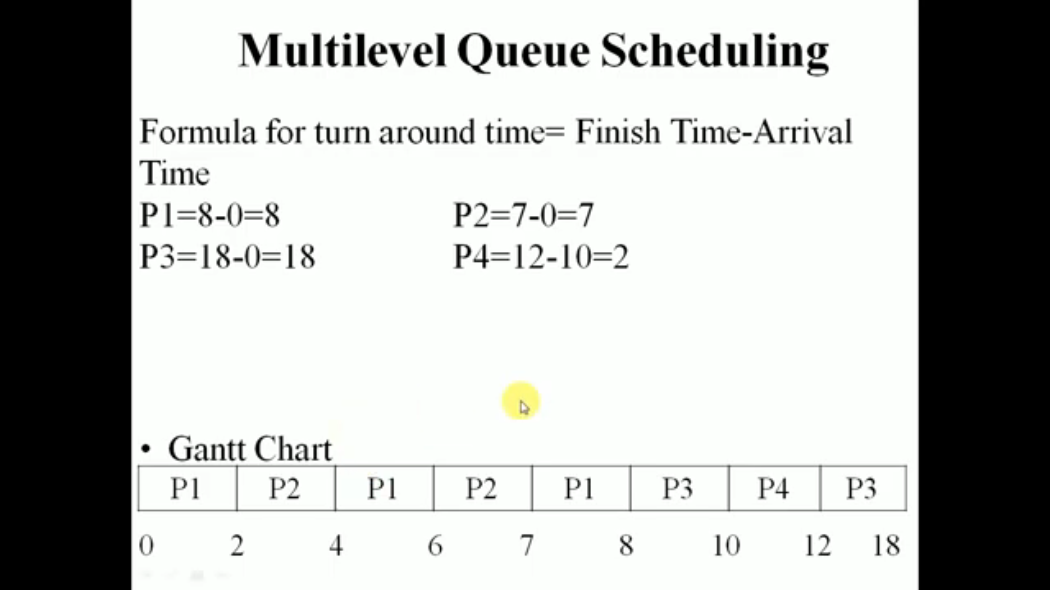

Slide 41
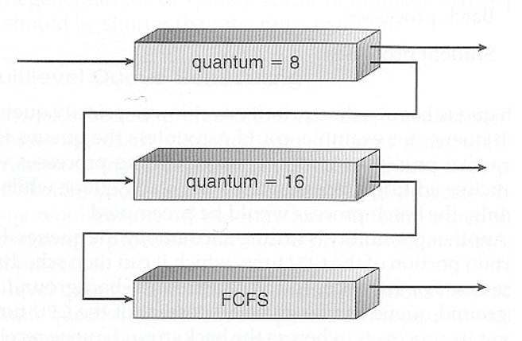
Multilevel Feedback-Queue Scheduling, MFQS:

Slide 42
Resource Allocation and Management:

Slide 43
Aims and Objectives:
Some issues of resource allocation
Allocation Mechanisms & Allocation Policies

Slide 44
Allocation Mechanisms:
A resource is a component of the computer system for which processes can compete. Typically these are: Central Processors, Memory, Peripherals, Backing Store, Files.

Slide 45


Slide 46
Allocating Resources Issues:
Mutual Exclusion of processes from non-shareable resources.
Deadlock should be handled sensibly.
Ensure high level of resource utilization.
Processes should be allocated resources within a reasonable length of time.
- The last two points compromise each other. OS can ensure high level of resource utilisation, but sometimes compromising response times for process completion.

Slide 47
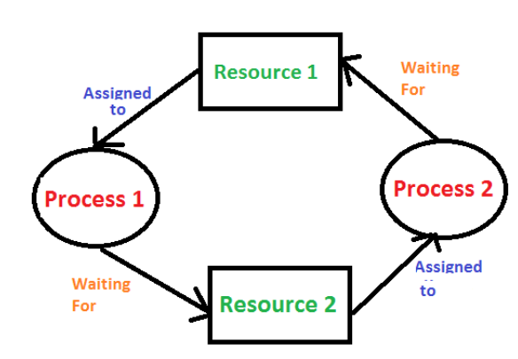
Deadlock is a situation where a set of processes are blocked because each process is holding a resource and waiting for another resource acquired by some other process.

Slide 48
Deadlock can arise if the following four conditions hold simultaneously (Necessary Conditions) :
Mutual Exclusion: One or more than one resource are non-shareable (Only one process can use at a time)
Hold and Wait: A process is holding at least one resource and waiting for resources.
No Preemption: A resource cannot be taken from a process unless the process releases the resource.
Circular Wait: A set of processes are waiting for each other in circular form.

Slide 49
Suppose n processes, P1, …. Pn share m identical resource units, which can be reserved and released one at a time. The maximum resource requirement of process Pi is Si, where Si > 0.

Slide 50
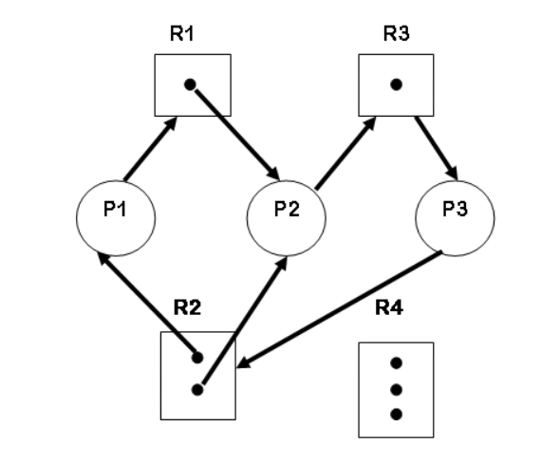
Deadlock can be solved by preventing any one of the conditions from holding
Detection and Recovery
Resource Allocation graph describes the deadlock more precisely:

Slide 51
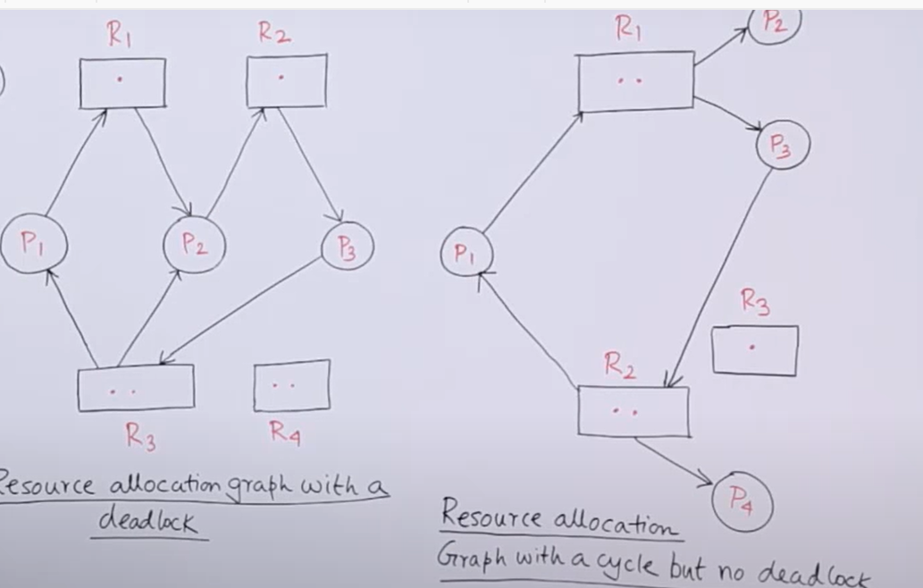
Deadlock examples

Slide 52
System Model
System consists of resources
Resource types R₁, R₂, . . ., R_{m}
CPU cycles, memory space, I/O devices
Each resource type R_{i} has W_{i} instances.
Each process utilizes a resource as follows:
request
use
release

Slide 53
Deadlock Characterization
Deadlock can arise if four conditions hold simultaneously.
Mutual exclusion: only one process at a time can use a resource
Hold and wait: a process holding at least one resource is waiting to acquire additional resources held by other processes
No preemption: a resource can be released only voluntarily by the process holding it, after that process has completed its task
Circular wait: there exists a set {P₀, P₁, …, P_{n}} of waiting processes such that P₀ is waiting for a resource that is held by P₁, P₁ is waiting for a resource that is held by P₂, …, P_{n–1} is waiting for a resource that is held by P_{n}, and P_{n} is waiting for a resource that is held by P₀.

Slide 54
Resource-Allocation Graph
A set of vertices V and a set of edges E.
V is partitioned into two types:
P = {P₁, P₂, …, P_{n}}, the set consisting of all the processes in the system
R = {R₁, R₂, …, R_{m}}, the set consisting of all resource types in the system
request edge – directed edge P_{i} → R_{j}
assignment edge – directed edge R_{j} → P_{i}

Slide 55
Resource-Allocation Graph (Cont.)
Process
Resource Type with 4 instances
P_{i} requests instance of R_{j}
P_{i} is holding an instance of R_{j}
P_{i}
R_{j}
P_{i}
R_{j}

Slide 56
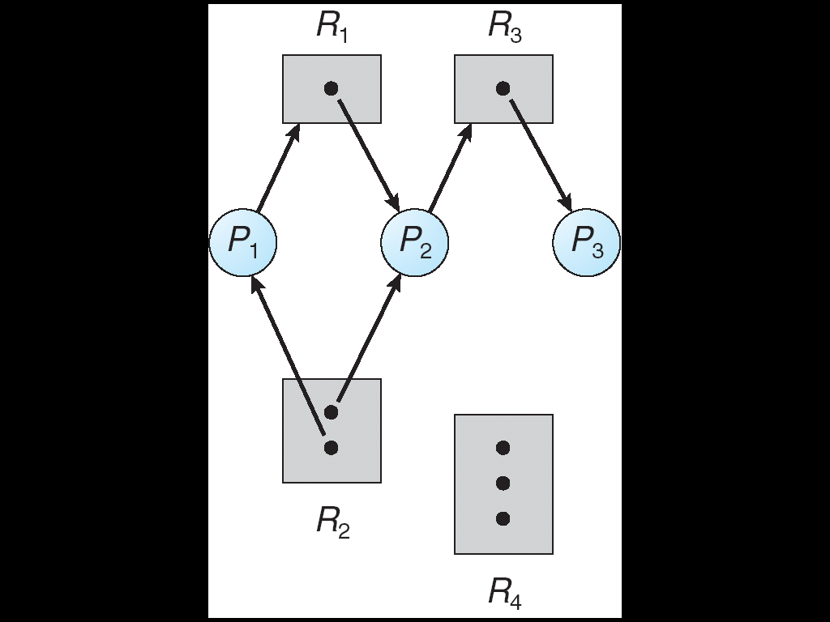
Example of a Resource Allocation Graph

Slide 57
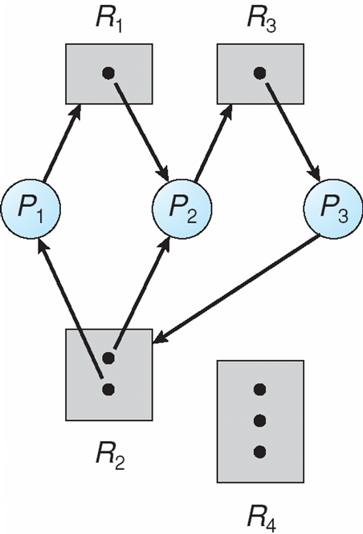
Resource Allocation Graph With A Deadlock

Slide 58
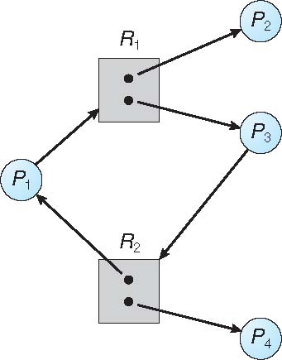
Graph With A Cycle But No Deadlock

Slide 59
Basic Facts
If graph contains no cycles ⇒ no deadlock
If graph contains a cycle ⇒
if only one instance per resource type, then deadlock
if several instances per resource type, possibility of deadlock

Slide 60
Basic Facts
If a system is in safe state ⇒ no deadlocks
If a system is in unsafe state ⇒ possibility of deadlock
Avoidance ⇒ ensure that a system will never enter an unsafe state.

Slide 61
Avoidance Algorithms
Single instance of a resource type
Use a resource-allocation graph
Multiple instances of a resource type
Use the banker’s algorithm

Slide 62
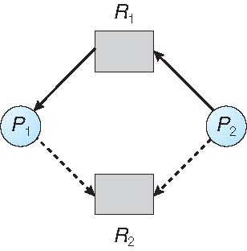
Resource-Allocation Graph

Slide 63
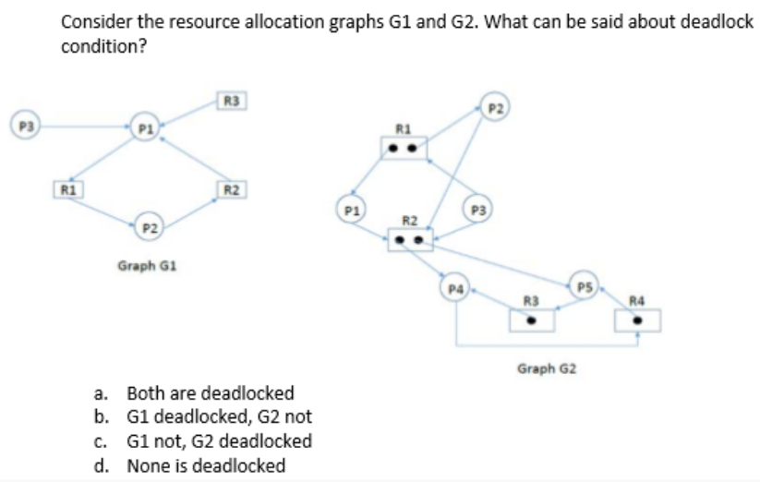

Slide 64
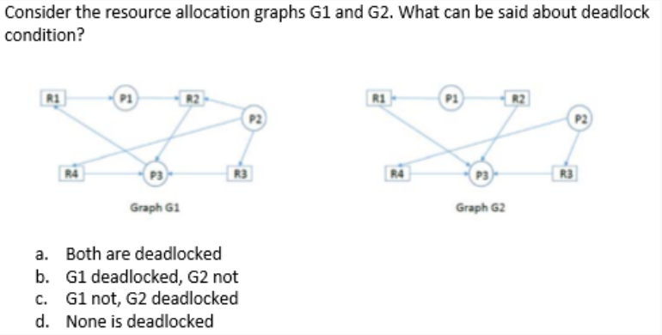
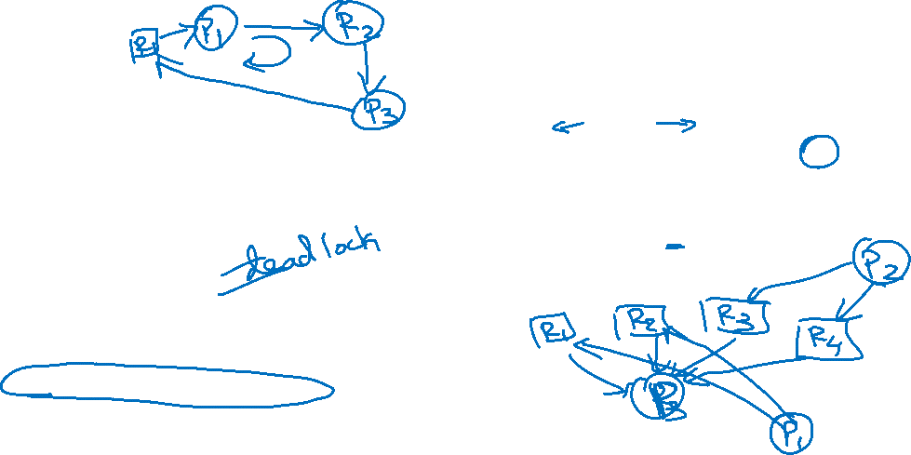

Slide 65
Avoidance by Anticipation
In deadlock avoidance, the request for any resource will be granted if the resulting state of the system doesn't cause deadlock in the system. The state of the system will continuously be checked for safe and unsafe states.
In order to avoid deadlocks, the process must tell OS, the maximum number of resources a process can request to complete its execution.
The simplest and most useful approach states that the process should declare the maximum number of resources of each type it may ever need. The Deadlock avoidance algorithm examines the resource allocations so that there can never be a circular wait condition.

Slide 66
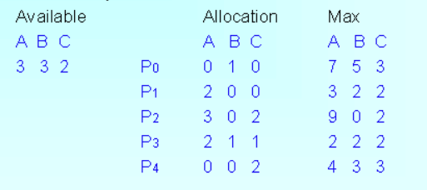
Example 1:

Slide 67
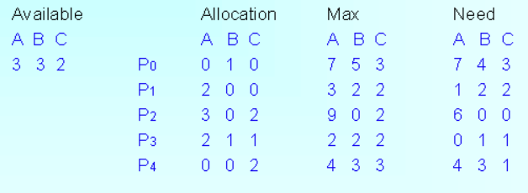

Slide 68
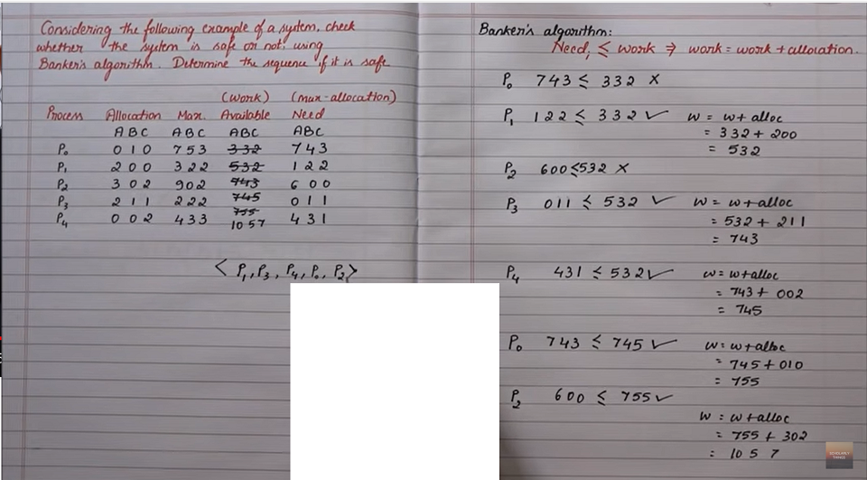

Slide 69
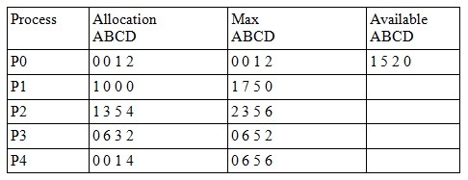
Example 2 :

Slide 70
Deadlock Handling mechanisms
Deadlock prevention
Deadlock happens only when Mutual Exclusion, hold and wait, No preemption and circular wait holds simultaneously. If it is possible to violate one of the four conditions at any time then the deadlock can never occur in the system.
Deadlock avoidance
In deadlock avoidance, the operating system checks whether the system is in safe state or in unsafe state at every step which the operating system performs. The process continues until the system is in safe state. Once the system moves to unsafe state, the OS has to backtrack one step.

Slide 71
Deadlock detection and recovery
This approach let the processes fall in deadlock and then periodically check whether deadlock occur in the system or not. If it occurs then it applies some of the recovery methods to the system to get rid of deadlock.

Slide 72
Recovery from Deadlock: Process Termination
Abort all deadlocked processes
Abort one process at a time until the deadlock cycle is eliminated
In which order should we choose to abort?
Priority of the process
How long process has computed, and how much longer to completion
Resources the process has used
Resources process needs to complete
How many processes will need to be terminated
Is process interactive or batch?

Slide 73
Recovery from Deadlock: Resource Preemption
Selecting a victim – minimize cost
Rollback – return to some safe state, restart process for that state
Starvation – same process may always be picked as victim, include number of rollback in cost factor

Slide 74
References:
1. Abraham Silberschatz, Greg Gagne, and Peter Baer Galvin, "Operating System Concepts, Eighth Edition”

